Slide 1



South Africa Energy Analysis 2014 -2023
View in Power BI
Last data refresh:
2/6/2025 2:25:01 PM UTC
Downloaded at:
2/6/2025 2:34:48 PM UTC

Slide 2
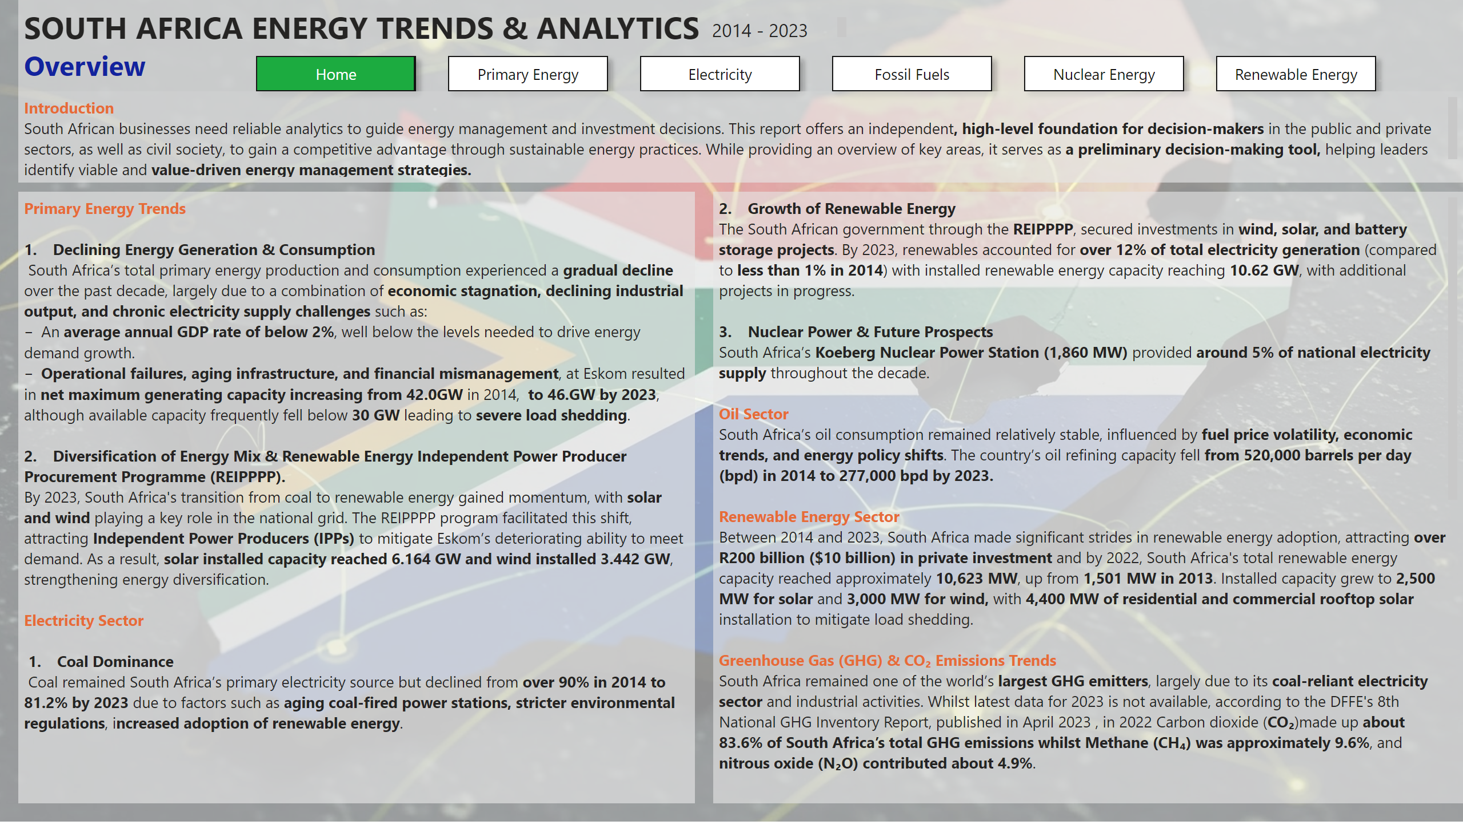
Home
Notes:
textbox
No alt text provided
textbox
No alt text provided
pageNavigator
No alt text provided
textbox
No alt text provided
textbox
No alt text provided
textbox
No alt text provided

Slide 3
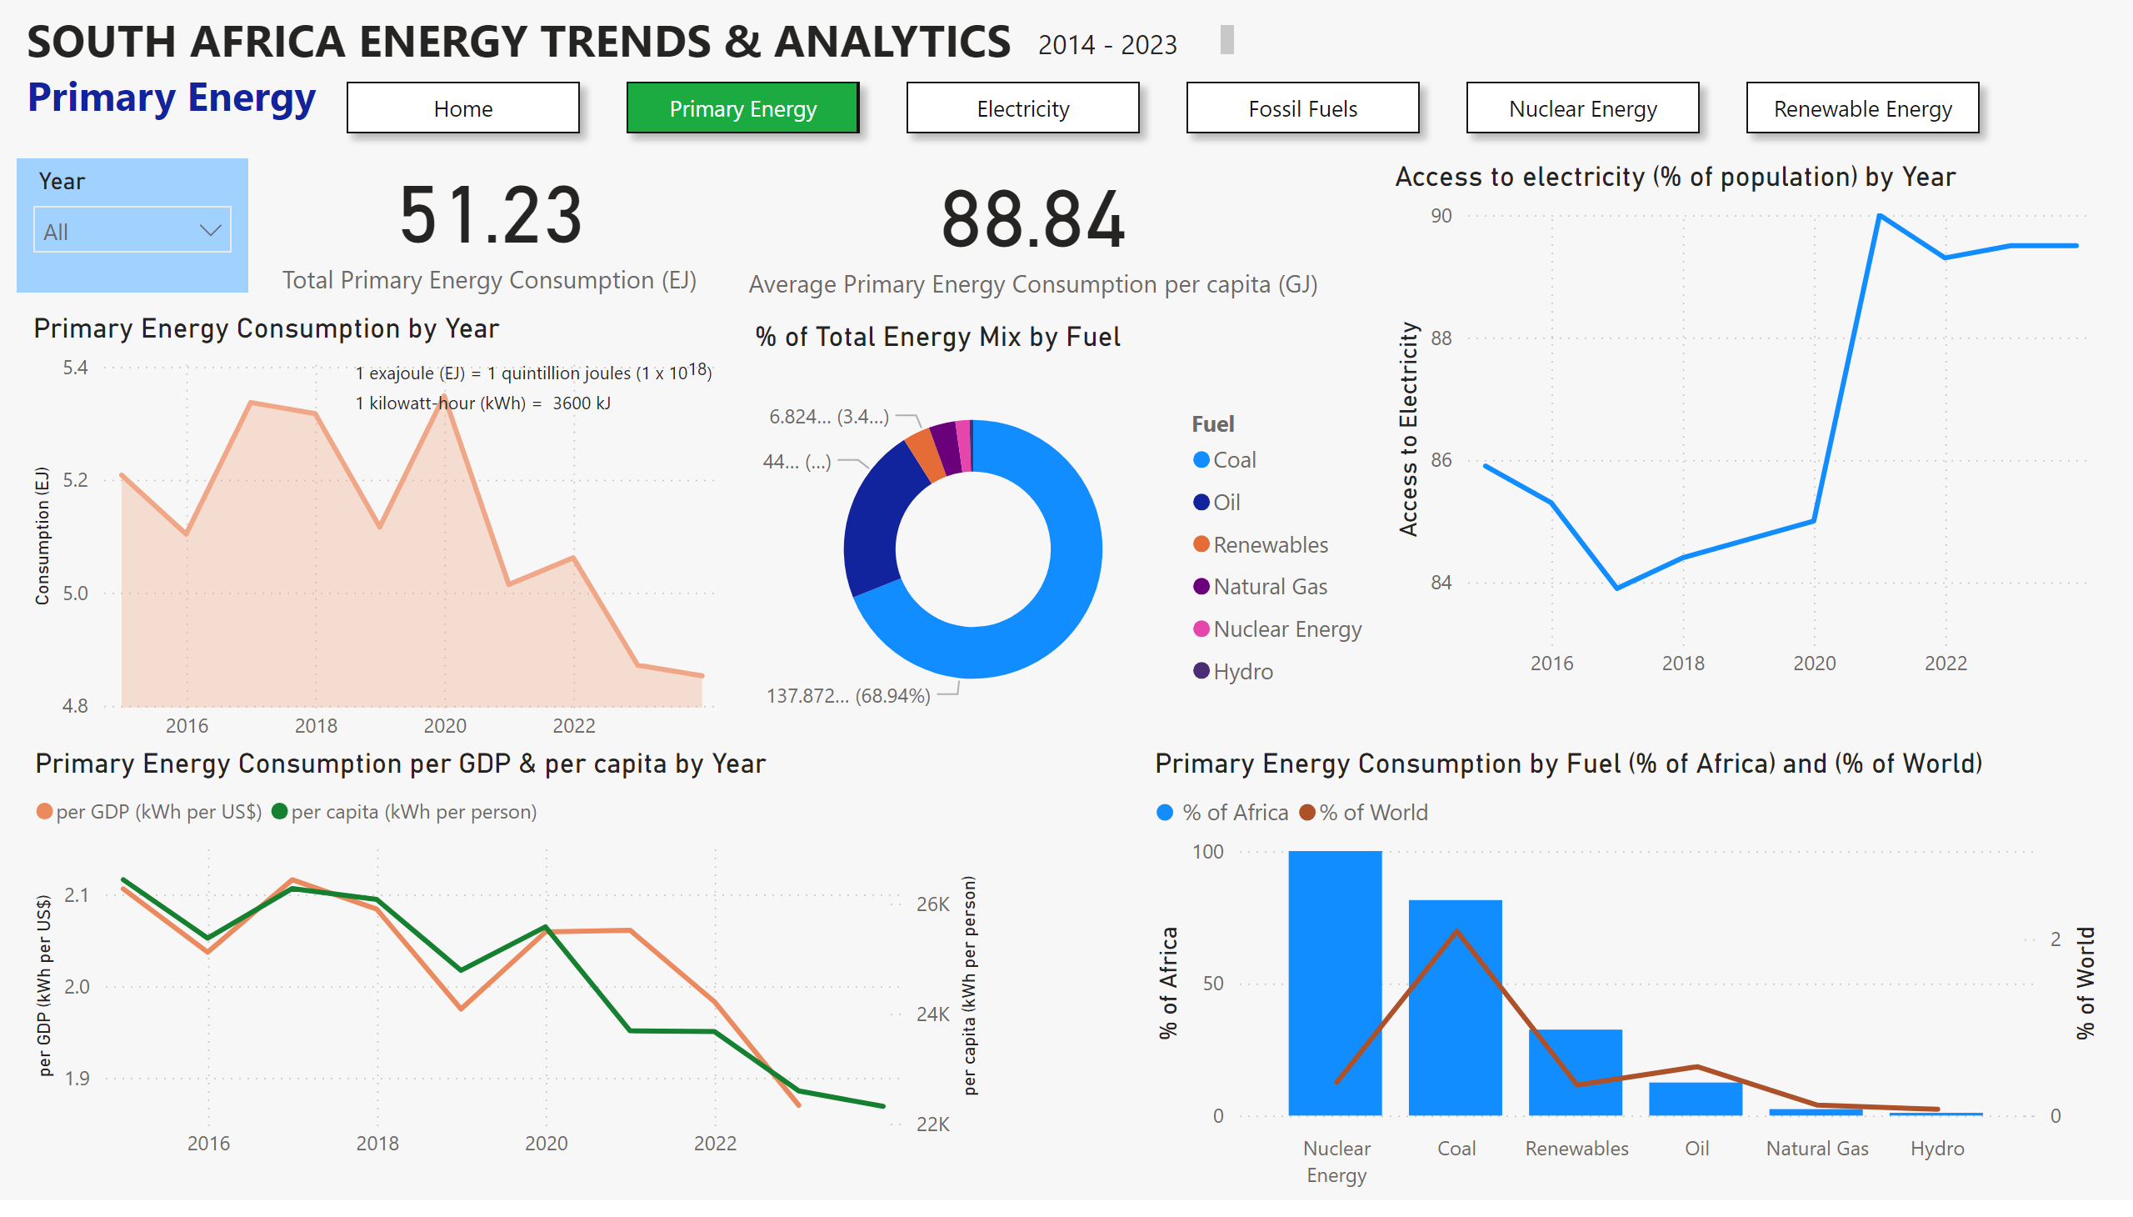
Primary Energy
Notes:
textbox
No alt text provided
slicer
No alt text provided
Primary Energy Consumption by Year
No alt text provided
card
No alt text provided
card
No alt text provided
Primary Energy Consumption by Fuel (% of Africa) and (% of World)
No alt text provided
donutChart
No alt text provided
textbox
No alt text provided
Primary Energy Consumption per GDP & per capita by Year
No alt text provided
pageNavigator
No alt text provided
Access to electricity (% of population) by Year
No alt text provided
textbox
No alt text provided

Slide 4
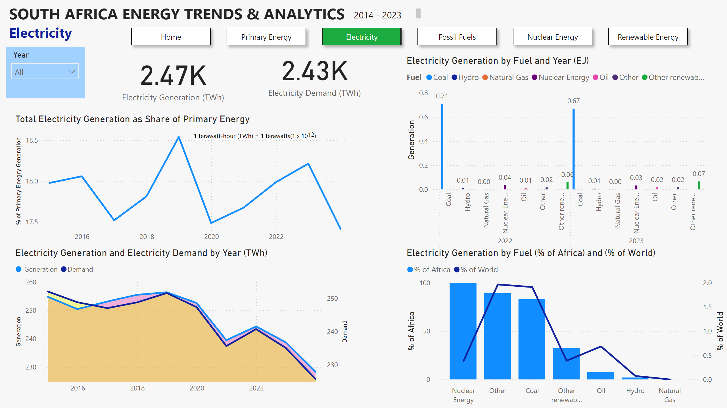
Electricity
Notes:
textbox
No alt text provided
slicer
No alt text provided
textbox
No alt text provided
card
No alt text provided
card
No alt text provided
Electricity Generation and Electricity Demand by Year (TWh)
No alt text provided
Electricity Generation by Fuel and Year (EJ)
No alt text provided
Electricity Generation by Fuel (% of Africa) and (% of World)
No alt text provided
Total Electricity Generation as Share of Primary Energy
No alt text provided
pageNavigator
No alt text provided
textbox
No alt text provided

Slide 5
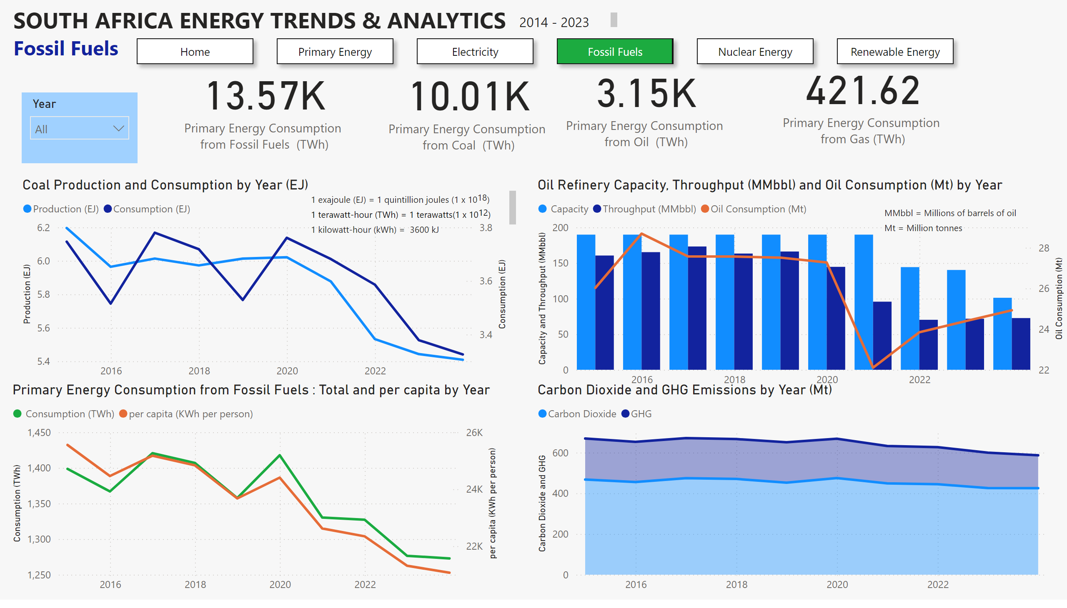
Fossil Fuels
Notes:
textbox
No alt text provided
slicer
No alt text provided
textbox
No alt text provided
Coal Production and Consumption by Year (EJ)
No alt text provided
Oil Refinery Capacity, Throughput (MMbbl) and Oil Consumption (Mt) by Year
No alt text provided
Primary Energy Consumption from Fossil Fuels : Total and per capita by Year
No alt text provided
card
No alt text provided
card
No alt text provided
card
No alt text provided
Carbon Dioxide and GHG Emissions by Year (Mt)
No alt text provided
card
No alt text provided
pageNavigator
No alt text provided
textbox
No alt text provided
textbox
No alt text provided

Slide 6
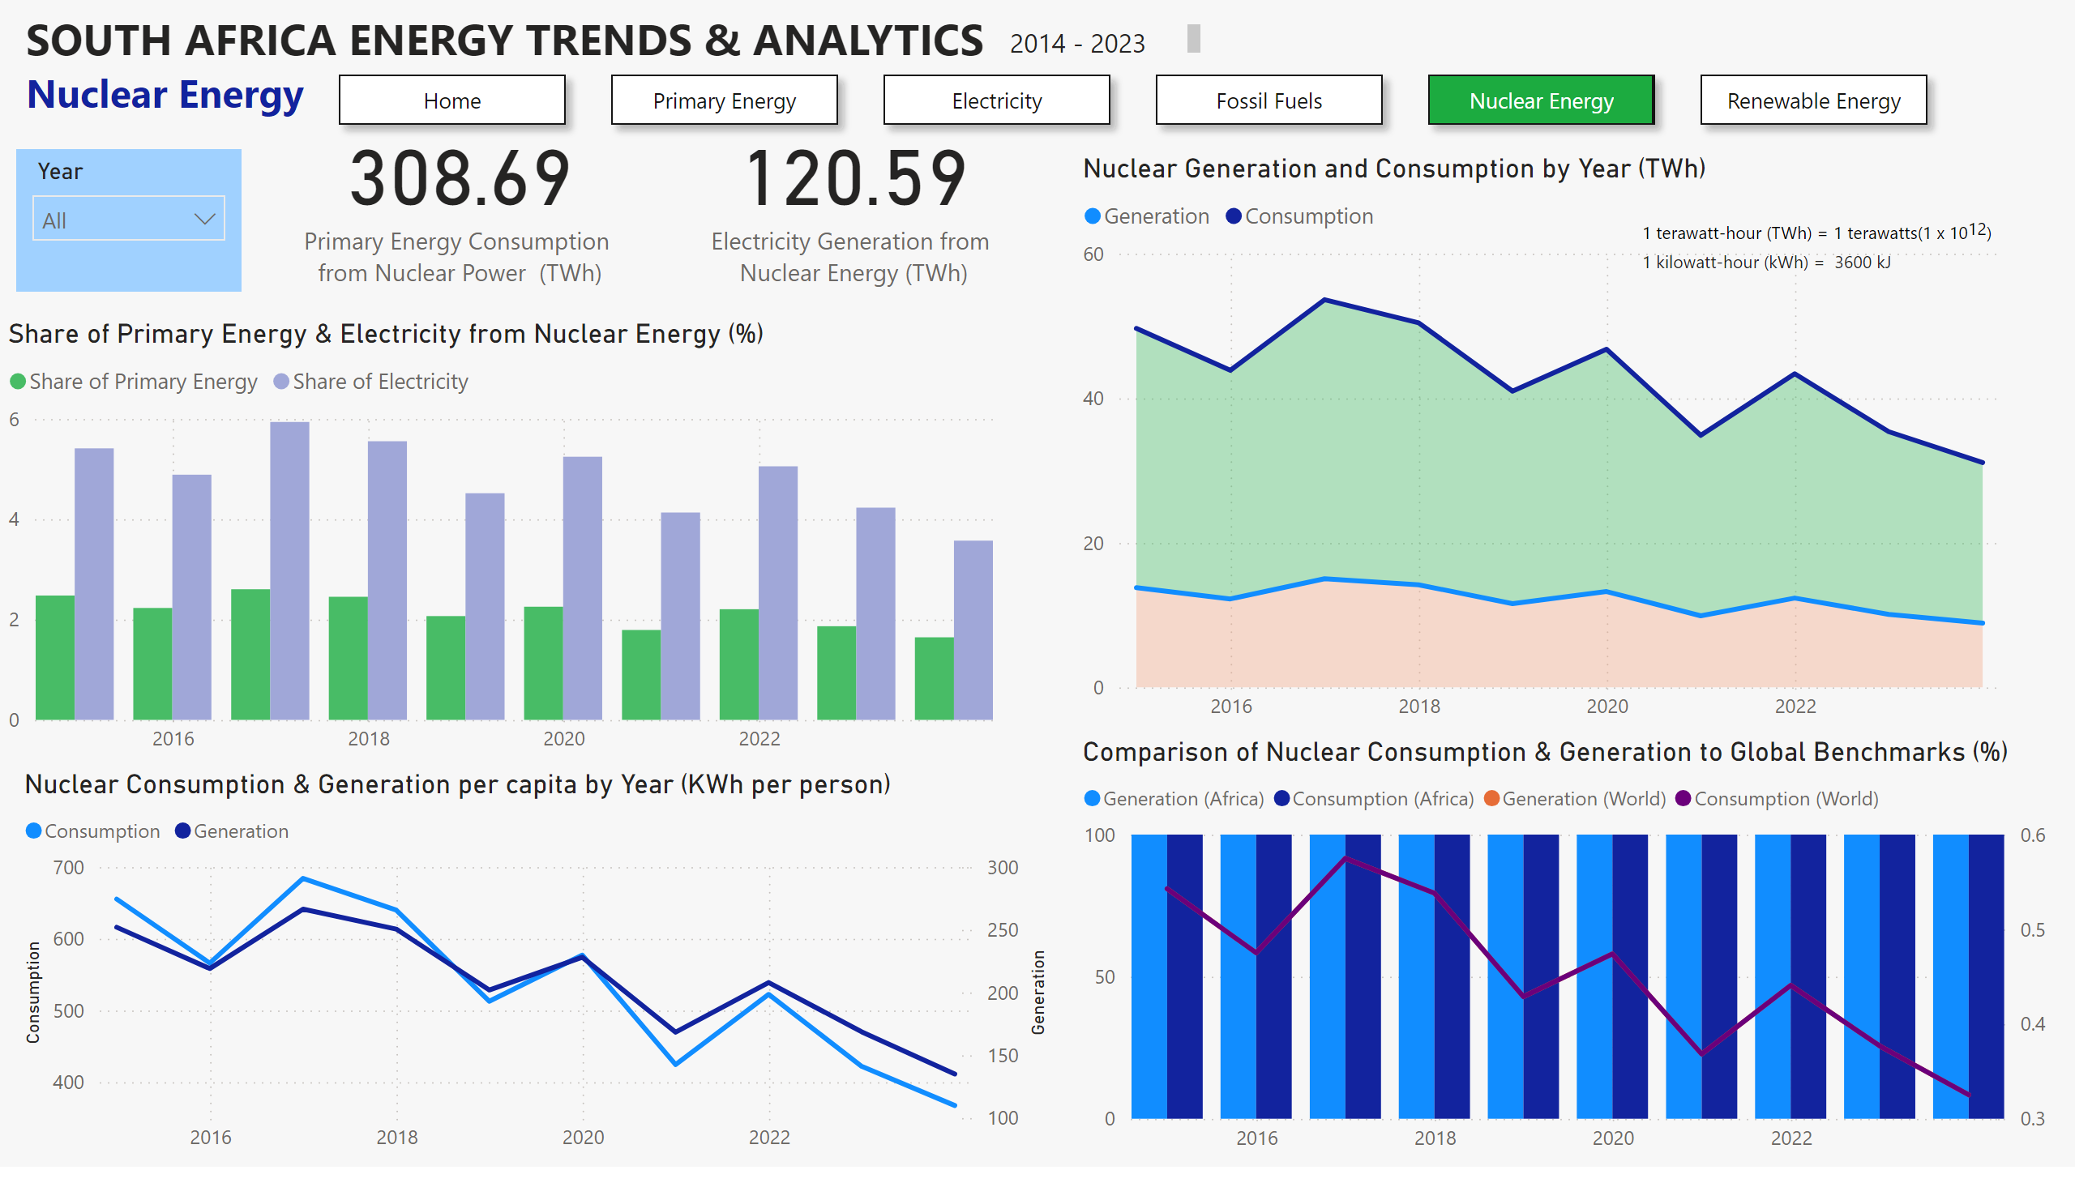
Nuclear Energy
Notes:
textbox
No alt text provided
slicer
No alt text provided
textbox
No alt text provided
Nuclear Generation and Consumption by Year (TWh)
No alt text provided
Share of Primary Energy & Electricity from Nuclear Energy (%)
No alt text provided
card
No alt text provided
card
No alt text provided
Nuclear Consumption & Generation per capita by Year (KWh per person)
No alt text provided
Comparison of Nuclear Consumption & Generation to Global Benchmarks (%)
No alt text provided
pageNavigator
No alt text provided
textbox
No alt text provided

Slide 7
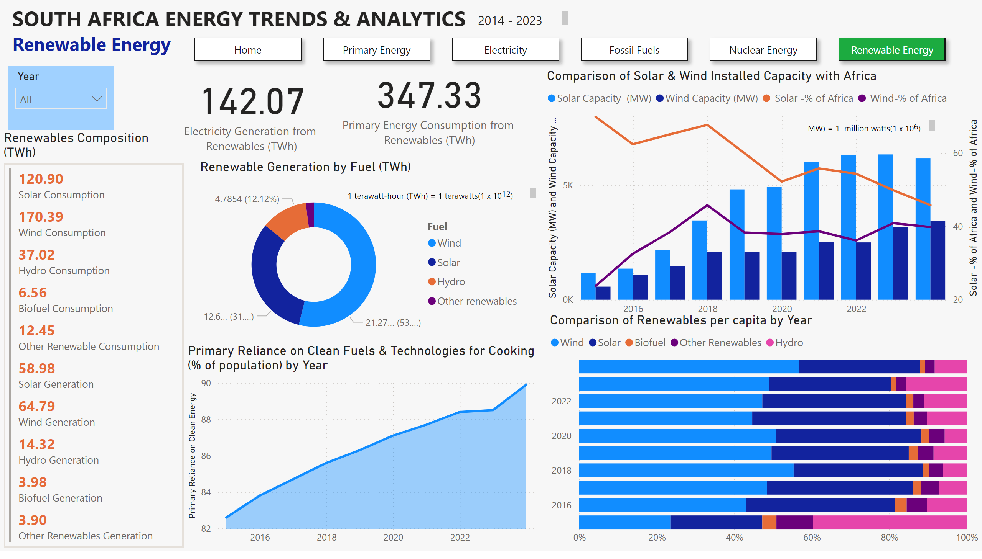
Renewable Energy
Notes:
textbox
No alt text provided
slicer
No alt text provided
textbox
No alt text provided
card
No alt text provided
card
No alt text provided
Renewables Composition (TWh)
No alt text provided
Comparison of Solar & Wind Installed Capacity with Africa
No alt text provided
Comparison of Renewables per capita by Year
No alt text provided
Renewable Generation by Fuel (TWh)
No alt text provided
pageNavigator
No alt text provided
Primary Reliance on Clean Fuels & Technologies for Cooking (% of population) by Year
No alt text provided
textbox
No alt text provided
textbox
No alt text provided

